Slide 1



Hospital Stay Duration
Analysis by Tracy Dower & Blake Armstrong
MSDS 6732 – Applied Statistics
Notes:
BLAKE

Slide 2


Hospital Stay Duration
Exploring:
What drives it?
Can we predict it?
Impacts:
Potential increased risk of hospital-acquired infections/complications
Financial burden
Extended stays limit bed availability, delaying care for others
Outcomes:
Determine driving factors and predict stay duration to maximize patient care and drive efficient operations
Notes:
TRACY
Each extra day that a patient stays in the hospital comes with a cost. It increases the financial burden, and more importantly, it raises the risk of hospital-acquired infections and complications.
Patients want to be home with family
And other patients need the beds That’s why it is critical to understand the factors driving hospital stay duration.
In this project, we worked with data from 113 hospitals across four U.S. regions.
First, what drives hospital stay duration? Our first objective was to determine which hospital characteristics most significantly influence the average length of stay for patients.
This is critical because when hospitals know what factors are driving longer stays, they can focus on what to control. This can lead to better patient outcomes, lower costs, and more efficient resource management.
This question is important because understanding these factors can help hospitals make data-driven decisions to improve patient care and resource management.
Understanding what drives length of stay can help hospitals control these factors, improve patient outcomes, and optimize resources.
Second, can we predict hospital stay duration?
Prediction matters because if hospitals can anticipate length of stay, they can plan ahead. They can better manage staffing, bed availability, and patient flow. This allows them to be proactive instead of reactive.
Data Objective(s) overview, project outline, and data description/variables used
Objective 1: Identify predictors that influence patient length of stay.
Objective 2: Build the most accurate predictive model for length of stay.
Dataset: 113 hospitals, 11 key variables including infection risk, number of beds, and region.

Slide 3

Exploring the Data
Dataset includes:
infection risk
patient age
medical school affiliation
region
average patient load
number of beds
Notes:
BLAKE
There were no missing or invalid data.
The dataset includes key variables
infection risk
Higher Infection risk was associated with longer hospital stay
patient age Region -- Northeast -- North Central -- South -- and West
We observed clear regional differences in the average length of stay.
medical school affiliation
Medical school affiliation means the hospital is formally connected to a medical school This often brings in medical students residents and teaching physicians These hospitals may have more research activity more specialized care and different staffing levels compared to hospitals with no affiliation
average patient load
number of beds
We note that the number of beds and the average patient load were strongly correlated with one another

Slide 4
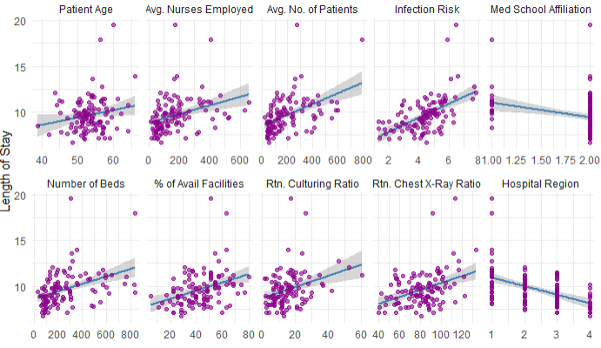
Length of Stay vs. Predictors
Notes:
BLAKE
This visual shows the relationship between hospital length of stay and each predictor in our dataset.
Several patterns stand out:
Patient Age: There’s a positive trend—older patient populations are generally associated with longer hospital stays.
Average Number of Nurses and Patients: Hospitals with more nurses and more patients tend to have longer stays. This may reflect larger or busier hospitals, but these variables are also highly correlated with hospital size.
Infection Risk: Higher infection risk is associated with longer stays, which makes sense—complications from infections often extend recovery time. Number of Beds: Length of stay increases with hospital size, but this is likely confounded by the same size effects we see with number of patients and number of nurses.
Available Facilities: Surprisingly, there’s no strong trend here. The percent of available facilities does not seem to strongly impact length of stay.
Routine Culturing and Chest X-Ray Ratios: There is a mild positive association, especially for chest X-rays, which could reflect hospitals that are more proactive in diagnostics having longer stays.
Medical School Affiliation: Hospitals with a medical school affiliation tend to have slightly shorter stays, possibly due to more standardized or cutting-edge practices, but this relationship is not very strong visually.
Hospital Region: There are clear regional differences in length of stay. Some regions tend to have systematically longer or shorter stays.
Overall, infection risk, patient age, hospital size, and regional differences appear to be key drivers of length of stay, which guided our model selection process.
We tried log transforming the length of stay, and also the predictors variables and the models did not improve

Slide 5
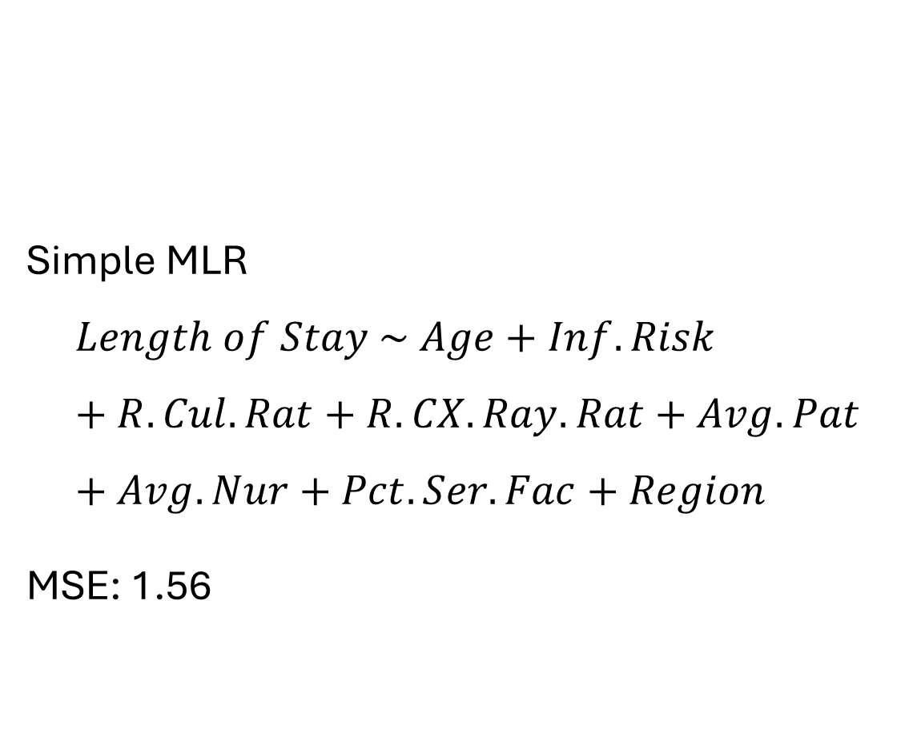
Objective 1: Linear Regression with Untransformed Predictors
Simple MLR
$$Length of Stay \sim Age+Inf.Risk+R.Cul.Rat+R.CX.Ray.Rat+Avg.Pat+Avg.Nur+Pct.Ser.Fac+Region$$
MSE: 1.56
Notes:
BLAKE
Model 1: Linear Regression with Untransformed Predictors
We started by fitting a baseline linear regression model using infection risk as the sole predictor for length of stay.
Cross-Validation Results (5-fold, 10 repeats):
MSE: 1.56
INTERPRETATION ON NEXT SLIDE
INTERPRETATION ON NEXT SLIDE
INTERPRETATION ON NEXT SLIDE

Slide 6

Average Length of Stay vs. Infection Risk Key Findings from the Full Model
Infection Risk is statistically significant. Each 1% increase in infection risk is associated with a mean 0.453-day increase in length of stay, holding all other variables constant, with a 95% confidence interval of 0.24 to 0.66 days (p < 0.001).
Other significant predictors:
Age
Region
Average Patients
Average Nurses
Notes:
TRACY
As introduced earlier, Objective 1 is to determine whether a hospital’s infection risk is significantly associated with average length of stay, after accounting for other potentially influential factors.
We used multiple strategies:
Traditional multiple linear regression with all predictors
Stepwise feature selection (forward, backward, both)
LASSO regression
These methods allowed us to verify the importance of infection risk while controlling for other hospital characteristics.
Key Findings from the Full Model:
When holding all other variables constant:
Infection Risk is statistically significant. READ THE SLIDE
Other significant predictors:
Age: Older patient populations are linked to longer stays.
Region: Regional differences significantly affect length of stay.
Average Patients: Larger hospitals with more daily patients tend to have longer stays.
Average Nurses: Higher nurse staffing is slightly associated with shorter stays.
Interpretation:
This model explains very little variance in the outcome.
The low R-squared value confirms that infection risk alone is not sufficient to predict hospital stay duration accurately.
Additional Observations:
Similar to what we saw in the linear scatterplots, most of the data clusters at the lower end of the predictor range.
This supports the idea that variable transformations, such as log-scaling, could improve the model fit and help reduce the skewed distribution.
Model: Length of Stay ~ Age + Inf.Risk + R.Cul.Rat + R.CX.ray.Rat + Avg.Pat + Avg.Nur + Pct.Ser.Fac + Region
MSE: 1.1049
Significant Predictors: Age, Inf.Risk, Avg.Pat, Avg.Nur, Region
Example: 1% increase in infection risk increases length of stay by ~0.53 days (95% CI: 0.24 to 0.81 days).

Slide 7
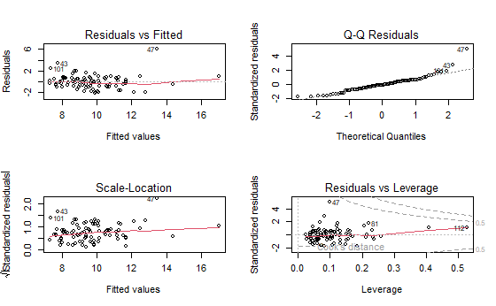
Assumptions of Multiple Linear Regression
Normality
Homoscedasticity
Independence
Notes:
TRACY
We assessed the key assumptions of multiple linear regression: linearity, independence, normality of residuals, and homoscedasticity.
Normality: The Q-Q plot of residuals showed that most residuals fall along the 45-degree reference line, with some minor deviations in the tails.
This indicates approximate normality of residuals, which is acceptable for regression inference.
Homoscedasticity:
The residuals versus fitted values plot indicates mild funneling, which suggests possible heteroscedasticity.
However, the pattern is not severe enough to invalidate the model, and cross-validation results show stable predictive performance.
Independence:
We examined Independence using the Variance Inflation Factors (VIF).
(next slide)

Slide 8

Assessing the Independence of Predictors using Variance Inflation Factors (VIF)
Predictor | VIF
Age | 1.16
Region | 1.33
Chest X-Ray Ratio | 1.46
Routine Culturing Ratio | 1.72
Infection Risk | 1.95
Percent Facility Use | 3.21
Average Nurses | 6.87
Average Patients | 30.36
Number of Beds | 33.52
Notes:
TRACY
2 predictors
Number of Beds and Average Patient Load show high multicollinearity,
N.Beds (VIF = 33.52) and Avg.Pat (VIF = 30.36)
Number of Beds and Average Patient Load are both measures of hospital capacity, and are therefore somewhat redundant.
Thus we removed Number of Beds from our models to improve independence.
All other predictors have VIF values well below 10,
indicating low multicollinearity
and supporting the assumption of independence among the remaining predictors.

Slide 9
Objective 1: Final Model – Simple Linear Regression
Characteristic | Beta | 95% CI | p-value | VIF
(Intercept) | 3.241 | 0.104 to 6.379 | 0.043
Age | 0.079 | 0.027 to 0.131 | 0.003 | 1.0
Inf. Risk | 0.453 | 0.241 to 0.664 | <0.001 | 1.5
R. CX-ray Rat | 0.013 | 0.000 to 0.027 | 0.057 | 1.4
Avg. Patients | 0.010 | 0.006 to 0.013 | <0.001 | 5.8
Avg. Nurses | -0.007 | -0.011 to -0.003 | <0.001 | 5.9
Region | -0.618 | -0.860 to -0.376 | <0.001 | 1.1
Notes:
BLAKE
Objective 1: Final Model – Simple Linear Regression
After feature selection and diagnostics, we finalized a simplified multiple linear regression model that retained the most meaningful predictors.
Key Findings:
Infection Risk remains a highly significant predictor of hospital stay duration after adjusting for other factors.
Age, region, and hospital size (patients and nurses) also significantly influence length of stay.
Higher nurse staffing is associated with shorter stays, suggesting that better resourcing may improve patient throughput.
Low VIF values indicate minimal multicollinearity in this simplified model.
Next Step:
We will now review the residual diagnostics for this final model to confirm the model assumptions and overall fit.
Automatic Feature Selection: LASSO For our linear-linear model, we applied LASSO regression to automatically select predictors and control model complexity.
We used cross-validation to find the optimal penalty term, lambda (λ), that minimizes the mean squared error.
This plot shows the LASSO cross-validation results.
The x-axis represents different values of log(λ).
The y-axis shows the mean squared error (MSE) for each lambda.
The vertical dashed line indicates the λ value that minimizes the MSE.
Key Takeaways:
The lowest mean squared error occurred at the selected lambda, which balances prediction accuracy and model simplicity.
LASSO effectively reduced the number of predictors by shrinking some coefficients to zero, helping to control overfitting and multicollinearity.
The final model retained only the most relevant variables for predicting hospital stay duration.

Slide 10

Advanced Modeling of Hospital Length of Stay
Notes:
BLAKE
Here we seek to model the factors associated with increased hospital stay duration.
The first thing we did was look at interactions

Slide 11
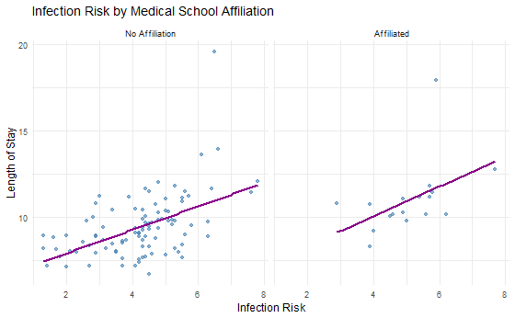
Interaction between Medical School and Infection Risk
Notes:
BLAKE
EDA Support for Interactions
Exploratory Data Analysis suggested some potential interactions.
The visual trends suggest potential interaction effects between infection risk and region, as the strength of the relationship appears to differ across regions.
The was a much smaller difference in trends between hospitals affiliated with medical school affiliation and those that were not affiliated.
Affiliated hospitals show a slightly steeper positive trend, though visual evidence remains moderate.
Given the ambiguity, we proceeded to formally test these interactions.

Slide 12
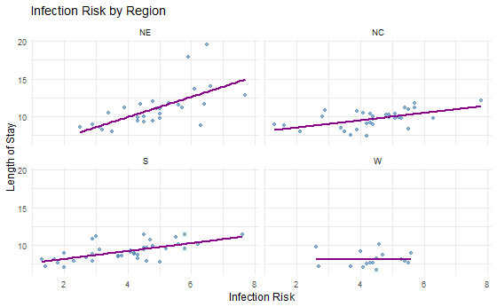
Interaction between Region and Infection Risk
Notes:
BLAKE
EDA Support for Interactions
Exploratory Data Analysis suggested some potential interactions.
The visual trends suggest potential interaction effects between infection risk and region, as the strength of the relationship appears to differ across regions.
The was a much smaller difference in trends between hospitals affiliated with medical school affiliation and those that were not affiliated.
Affiliated hospitals show a slightly steeper positive trend, though visual evidence remains moderate.
Given the ambiguity, we proceeded to formally test these interactions.

Slide 13

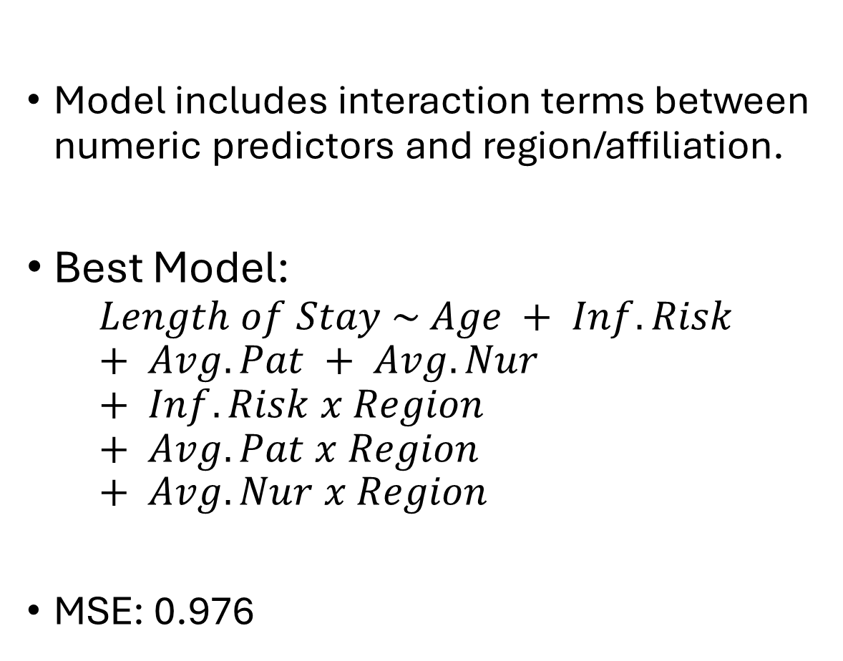
Complex MLR Model: All Predictors and Interactions
Model includes interaction terms between numeric predictors and region/affiliation.
Best Model:
$$Length of Stay \sim Age + Inf.Risk + Avg.Pat + Avg.Nur + Inf.Risk x Region + Avg.Pat x Region + Avg.Nur x Region$$
MSE: 0.976
Notes:
TRACY

Slide 14
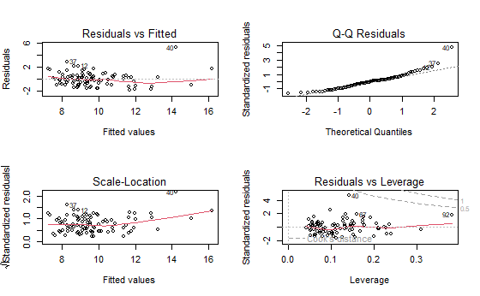

Residual Diagnostics: Complex MLR Model
Notes:
TRACY
Final Model Results and Residual Diagnostics
We tested a final refined model that included key variables and select interaction terms. However, this model produced a higher RMSE of 1.31, indicating it underperformed compared to the simplified stepwise model (RMSE = 0.99).
We conducted bootstrap validation to assess model stability. The results supported the reliability of the simplified model and indicated that the final model’s performance was not an improvement.
Residual Diagnostic Summary for Final Model
Residuals vs. Fitted Plot: There is mild funneling in the residuals, suggesting potential non-constant variance (heteroscedasticity). The residuals are not perfectly scattered and show some curvature, indicating the model may not fully capture the variance structure.
Q-Q Plot: The residuals generally follow the theoretical quantile line but deviate in the upper tail, suggesting a possible departure from normality. This could slightly impact inference but is not a severe issue.
Scale-Location Plot: The spread of residuals increases slightly with higher fitted values. This reinforces the mild heteroscedasticity observed earlier.
Residuals vs. Leverage Plot: No points exhibit both high leverage and large residuals, meaning there are no highly influential observations affecting the model's results.

Slide 15
Non-Parametric Model: Random Forest
Random Forest
80/20 Train/Test Split
# of Tree’s: 500
MSE: 0.886
Most Influential Parameter: Infection Risk
Notes:
BLAKE
For and additional nonparametric model, we tested random forest using a 80/20 train test split. We ran 500 trees and the model produced the lowest RMSE of 0.941.’
Additionally, from a variable importance plot, we found that Infection Risk is the most impactful in reducing MSE when predicting hospital duration, verifying that infection risk is a great predictor in estimating mean hospital stay duration.

Slide 16
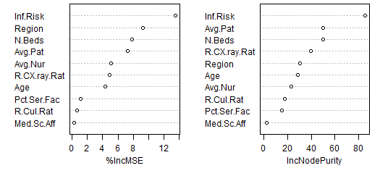
Random Forest Feature Importance
Notes:
BLAKE
randomForest(formula = Lgth.of.Sty ~ ., data = trainData, importance = TRUE, ntree = 500)
Type of random forest: regression
Number of trees: 500
No. of variables tried at each split: 3
Mean of squared residuals: 2.276706
% Var explained: 43.06
Mean Squared Error on Test Set: 0.8862835
Root Mean Squared Error on Test Set: 0.9414263 z

Slide 17
Model Comparison
Model | Validation MSE
Random Forest | 0.886
Simple MLR | 1.560
Complex MLR with Interactions | 0.976
Notes:
BLAKE
The simplified stepwise model provided the best balance between complexity and predictive accuracy, even though the Objective 1 model performed slightly better in MSE.

Slide 18

Conclusion
Infection risk and region significantly influence length of stay.
Complex MLR model provides the best predictive performance.
Future work: Test additional nonparametric methods, collect more data, explore more interaction terms.
Scope of inference: Hospitals with similar characteristics in the provided dataset.
Notes:
TRACY
Infection risk is a significant predictor, particularly when considering hospital region.
Complex models can lead to overfitting with minimal performance gain.
Feature selection is essential to balance model interpretability and accuracy.
If Given More Time:
Explore additional nonparametric models like Random Forest or kNN.
Investigate potential non-linearities and time effects.
Complex MLR model provides the best predictive performance.
Future work: Test additional nonparametric methods, collect more data, explore more interaction terms.
Scope of inference: Hospitals with similar characteristics in the provided dataset.

Slide 19

Thank you
Tracy Dower & Blake Armstrong
MSDS 6732 – Applied Statistics
Notes:
Tracy

